Slide 1
Inventra Intelligent Inventory Management System

Slide 2
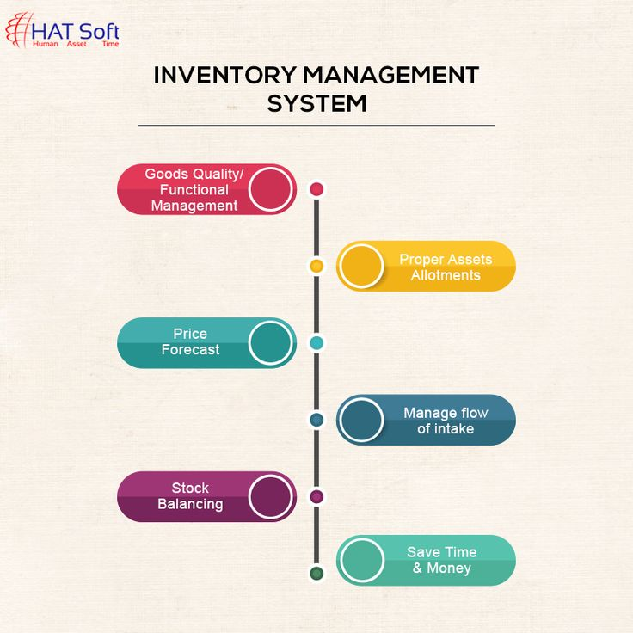
Inventra is an Inventory Management System that automates stock tracking, forecasting, and order management.
It aims to reduce human errors, optimize stock levels, and improve business efficiency.
The system intelligently predicts inventory needs and ensures smooth supply chain operations.
Inventra = Inventory + Intelligent Automation

Slide 3
Module 1: Authentication
The Authentication Module manages user login, registration, and access control.
Classes are :
1. User
Use: Stores user information (name, email, role).
Purpose: Identifies each user in the system.
2. AuthController
Use: Handles login, signup, and logout API requests.
Purpose: Receives user input and communicates with AuthService.
3. AuthService
Use: Validates credentials, encrypts passwords, generates JWT tokens.
Purpose: Core logic of authentication and authorization.
4. UserRepository
Use: Interacts with the database to fetch/save user records.
Purpose: Provides CRUD operations for users.
5. JwtUtil
Use: Generates, validates, and refreshes JWT tokens.
Purpose: Ensures secure communication between client and server.

Slide 4
Database Schema
Table: users
Column Name | Type | Description
user_id (PK) | INT | Unique user identifier
name | VARCHAR(100) | User full name
email | VARCHAR(150) | Unique email for login
password | VARCHAR(255) | Encrypted password
role | VARCHAR(50) | Admin / Manager / Staff
created_at | DATETIME | Account creation time
updated_at | DATETIME | Last update timestamp

Slide 5
Table:roles
 | Column Name | Type | Description
 | role_id (PK) | INT | Unique role ID
 | role_name | VARCHAR(50) | Role type
Table: User Roles
 | Column Name | Type | Description
 | role_id (PK) | INT | Unique role ID
 | role_name | VARCHAR(50) | Role type

Slide 6
Functional Flow

Slide 7
AUTHENTICATION MODULE – PSEUDOCODE
Classes involved
AuthController
AuthService
User
UserRepository
JWTUtility
EmailService (for forgot password)

Slide 8
1.SIGN-UP (REGISTER USER)
Purpose
Create a new user account
Only Admin can register employees
# AuthController – Signup
CLASS AuthController
FUNCTION signup(request)
userDetails = request data
result = AuthService.registerUser(userDetails)
RETURN result
END FUNCTION
END CLASS

Slide 9
## AuthService – Signup Logic
CLASS AuthService
FUNCTION registerUser(userDetails)
existingUser = UserRepository.findByUsername(userDetails.username)
IF existingUser exists THEN
RETURN "User already exists"
END IF
encryptedPassword = encrypt(userDetails.password)
newUser = create User
newUser.username = userDetails.username
newUser.password = encryptedPassword
newUser.role = userDetails.role
newUser.email = userDetails.email
UserRepository.save(newUser)
RETURN "Signup successful"
END FUNCTION
END CLASS

Slide 10
# AuthController – Signin
CLASS AuthController
FUNCTION signin(request)
username = request.username
password = request.password
token = AuthService.authenticate(username, password)
RETURN token
END FUNCTION
END CLASS
2. Sign-in (LOGIN USER)
🔹 Purpose
Authenticate user
Generate secure token

Slide 11
## AuthService – Signin Logic
CLASS AuthService
FUNCTION authenticate(username, password)
user = UserRepository.findByUsername(username)
IF user does not exist THEN
RETURN "Invalid username"
END IF
IF password matches encrypted password THEN
token = JWTUtility.generateToken(user)
RETURN token
ELSE
RETURN "Invalid password"
END IF
END FUNCTION
END CLASS

Slide 12
####AuthService – Forgot Password Logic
CLASS AuthService
FUNCTION processForgotPassword(email)
user = UserRepository.findByEmail(email)
IF user does not exist THEN
RETURN "Email not registered"
END IF
resetToken = generateResetToken()
save resetToken with user
EmailService.sendResetLink(email, resetToken)
RETURN "Password reset link sent"
END FUNCTION
END CLASS
### AuthController – Forgot Password
CLASS AuthController
FUNCTION forgotPassword(request)
email = request.email
result = AuthService.processForgotPassword(email)
RETURN result
END FUNCTION
END CLASS

Slide 13
#####RESET PASSWORD (After clicking link)
# EmailService – Reset Email
CLASS EmailService
FUNCTION sendResetLink(email, token)
create reset password link using token
send email to user
END FUNCTION
END CLASS
CLASS AuthController
FUNCTION resetPassword(token, newPassword)
result = AuthService.resetPassword(token, newPassword)
RETURN result
END FUNCTION
END CLASS
CLASS AuthService
FUNCTION resetPassword(token, newPassword)
user = find user by reset token
IF token invalid or expired THEN
RETURN "Invalid token"
END IF
encryptedPassword = encrypt(newPassword)
user.password = encryptedPassword
clear reset token
save user
RETURN "Password reset successful"
END FUNCTION
END CLASS

Slide 14
Module 2 : Product and Inventory Management System
The purpose of this module is to allow the system to store complete product details such as:
1.Product name
2.Category
3.Quantity
4.Price
5.Suppliers
6.Reorder Level
7.Stock Transactions
Main Classes in this Module is:
1.Product
2.Product Controller
3.Product Service
4.Product Respository

Slide 15
Flow: AuthController—AuthService—UserRespository--Database
Purpose
Manage products
Track stock levels
Prevent duplicate items

Slide 16
1.Product Class (Entity)
Pseudocode
CLASS Product
productId
sku
name
category
supplier
unitPrice
stockQuantity
minStockLevel
END CLASS
Explanation
•sku ensures uniqueness
•stockQuantity changes frequently
•minStockLevel used for alert
2. ProductController Class
Pseudocode
CLASS ProductController
FUNCTION addProduct(productData)
ProductService.addProduct(productData)
END FUNCTION
FUNCTION stockIn(productId, quantity)
ProductService.increaseStock(productId, quantity)
END FUNCTION
FUNCTION stockOut(productId, quantity)
ProductService.decreaseStock(productId, quantity)
END FUNCTION
END CLASS
Explanation
Receives UI requests
Sends work to service layer
Does not touch database directly

Slide 17
3. ProductService Class
Pseudocode
CLASS ProductService
FUNCTION addProduct(productData)
IF product SKU not exists THEN
save product
ELSE
RETURN "Duplicate Product"
END IF
END FUNCTION
FUNCTION increaseStock(productId, quantity)
product.stock += quantity
save product
TransactionService.log("STOCK_IN", productId, quantity)
AlertService.checkLowStock(product)
END FUNCTION
FUNCTION decreaseStock(productId, quantity)
IF product.stock >= quantity THEN
product.stock -= quantity
save product
TransactionService.log("STOCK_OUT", productId, quantity)
AlertService.checkLowStock(product)
ELSE
RETURN "Insufficient Stock"
END IF
END FUNCTION
END CLASS
Explanation
•Central inventory logic
•Updates stock
•Logs transactions
•Triggers alerts

Slide 18
4.ProductRepository Class
Pseudocode
CLASS ProductRepository
FUNCTION findById(productId)
RETURN product
END FUNCTION
FUNCTION save(product)
store product in database
END FUNCTION
END CLASS

Slide 19
Database Schema:
Class | Need DB table? | Reason
Product (model) | Yes | Stores product details
Product Repository | No | only perform DB queries
Product Service | No | Business logic layer
Product Controller | No | Request handling layer
➡ Only the product class requires a database table

Slide 20
MileStone – 3
Inventra Intelligent Inventory Management System
Module 3: Inventory/Alerts

Slide 21
Table Of Contents
1.Introduction
2. Purpose
3.Classes and Flow
4.Pseudocode
5.Conclusion

Slide 22
Introduction
Core Function: It is responsible for monitoring inventory levels and automatically generating alerts.
Mechanism: It works continuously in the background, checking stock data received from a separate inventory module.
Benefit: Its primary purpose is to help users take timely action before stock runs out. By reducing the need for manual monitoring, it adds intelligence and efficiency to the inventory system.

Slide 23
Purpose
The primary function of the Alert Module is to provide proactive, timely warnings about key changes or issues in a system. In an inventory system its goal is to prevent costly operational issues like running out of stock (stockouts) or having excessive stock (overstocking).
While its basic function is to compare real-time stock levels against predefined thresholds (reorder points) to generate alerts that help users take timely action before stock runs out, its advanced role is much broader. The module actively manages risk and exceptions by flagging issues like dead stock, unusual demand spikes, late shipments, and potential overstocking where capital is unnecessarily tied up. By automating these monitoring and flagging processes, the Alert Module converts raw data into actionable intelligence, boosting operational efficiency, reducing errors, and enabling managers to focus only on inventory items that require immediate attention or strategic review.

Slide 24
Key Classes:
Product: The fundamental object representing an inventory item, containing the current stock and the threshold that triggers alerts.
Alert: A concrete record created by the system when a threshold is breached, detailing the issue, the product, and the status.
AlertController: Handles external user requests (e.g., viewing or closing alerts) and routes them to the service layer.
AlertService: Executes the core business logic, constantly monitoring products, generating new alerts, and managing alert statuses.
AlertRepository: Manages all data interactions, specifically saving, retrieving, and updating Product and Alert records in the database.

Slide 25
Functional Flow
alert service----product repository----checks quantity < reorder level
alertservice ----alert repository-----creates alert
Alert controller----shows alert to ui
The AlertService initiates the check by collaborating with the ProductRepository, which retrieves data and verifies if the stock quantity is less than the reorder level. If the condition is met, the AlertService then instructs the AlertRepository to permanently save the new alert record. Finally, the AlertController retrieves and formats this record to display the warning notification directly on the User Interface (UI).

Slide 26
INVENTORY ALERTS MODULE PseudoCode
Purpose
1.Avoid stock-out
2.Inform responsible staff
AlertService Class
Pseudocode
CLASS AlertService
FUNCTION checkLowStock(product)
IF product.stock < product.minStockLevel THEN
NotificationService.sendAlert(product)
END IF
END FUNCTION
END CLASS
Explanation
Automatically triggered after stock change
Works silently in background

Slide 27
NotificationService Class
Pseudocode
CLASS NotificationService
FUNCTION sendAlert(product)
show dashboard alert
send email or SMS
END FUNCTION
END CLASS
Explanation
Uses communication channels
Improves operational efficiency

Slide 28
Key Benefits
The module's main advantage is shifting the process from manual, reactive tracking to automated, proactive management.
Prevents Stockouts: By notifying users when stock hits a critical reorder point, it ensures new orders are placed with enough lead time to avoid running out of product.
Reduces Errors: It eliminates the need for manual, error-prone monitoring of spreadsheets or physical counts.
Enables Timely Action: The core benefit mentioned in your slide is allowing users to "take timely action before the stock runs out." This maximizes sales opportunities and improves customer satisfaction.
Adds Intelligence: It provides an intelligent layer to the system, focusing management effort only on items that require attention, thereby boosting efficiency.

Slide 29
Conclusion
The Alert Module serves as a crucial intelligent layer within a system, typically an Inventory Management Solution, transforming it from a static record-keeper into a proactive decision-making tool.
Its fundamental purpose is to continuously monitor key metrics, such as stock levels, and automatically generate timely warnings when pre-defined thresholds are breached. This critical function allows users to take timely action before stock runs out, reducing the risks of stockouts and improving operational efficiency by minimizing the need for constant manual checks.

Slide 30
Thank you

